Slide 1
Python Class

Slide 2
Python Classes
Python is an object-oriented programming language (OOP). Unlike procedure-oriented programming, where the main emphasis is on functions, object-oriented programming stresses on objects.
An object is simply a collection of data (variables) and methods (functions) that act on those data. Similarly, a class is a blueprint for that object.
We can think of a class as a sketch (prototype) of a house. It contains all the details about the floors, doors, windows, etc. Based on these descriptions we build the house. House is the object.
As many houses can be made from a house's blueprint, we can create many objects from a class. An object is also called an instance of a class and the process of creating this object is called instantiation.

Slide 3
Python Classes
Like function definitions begin with the def keyword in Python, class definitions begin with a class keyword.
The first string inside the class is called docstring and has a brief description of the class. Although not mandatory, this is highly recommended.
A class creates a new local namespace where all its attributes are defined. Attributes may be data or functions.
There are also special attributes in it that begins with double underscores __. For example, __doc__ gives us the docstring of that class.
As soon as we define a class, a new class object is created with the same name. This class object allows us to access the different attributes as well as to instantiate new objects of that class.

Slide 4
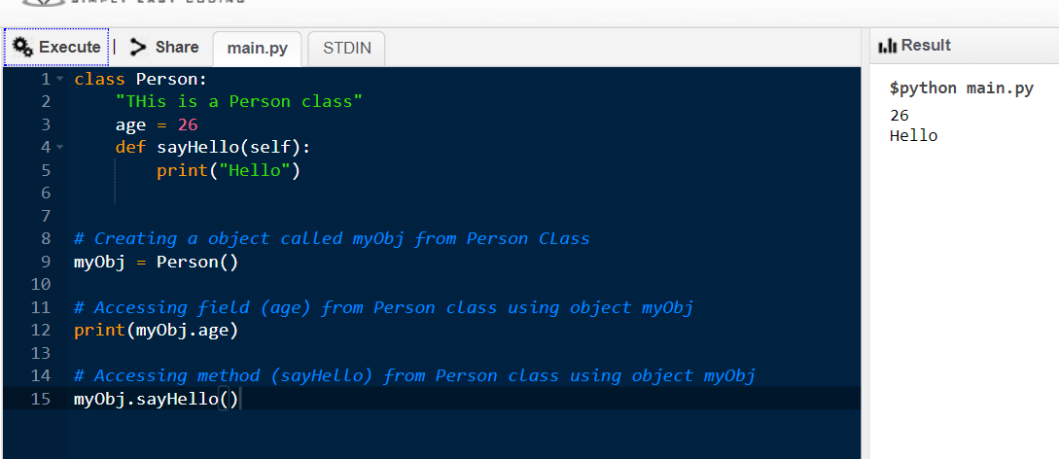
Python Classes
self : The first argument of the function in class must be the object itself. This is conventionally called self. It can be named otherwise but we highly recommend to follow the convention.

Slide 5
Python Objects
Class object is used to create new object instances (instantiation) of that class.
The procedure to create an object is similar to a function call.
myObj = Person()
This will create a new object instance named ‘myObj’. We can access the attributes of objects using the object name prefix.
Attributes may be data or method. Methods of an object are corresponding functions of that class.

Slide 6
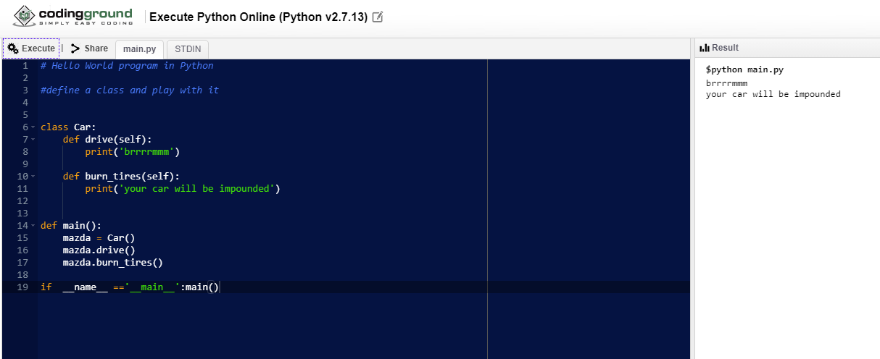
Objects
The __name__ variable (two underscores before and after) is a special inbuilt Python variable. It gets its value depending on how we execute the containing script.
When you run your script, the __name__ variable equals __main__. When you import the containing script, it will contain the name of the script.

Slide 7
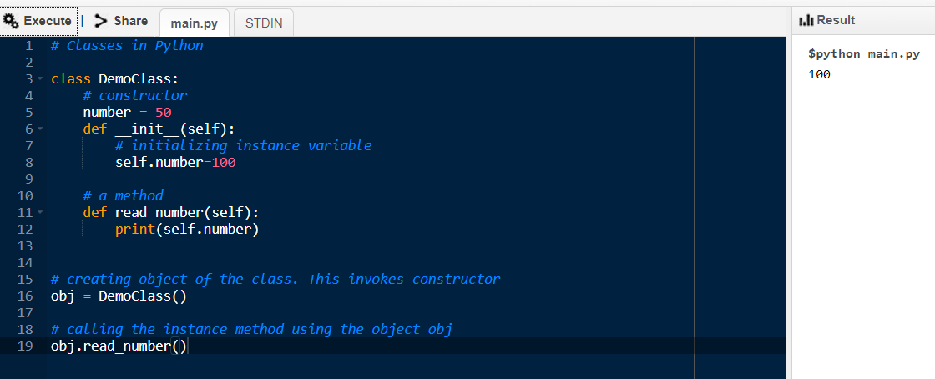
Constructor
Constructor is used for initializing the instance members when we create the object of a class.
Constructor is a special method inside the class
All classes have a function called __init__(), which is always executed when the class is being instantiated
Note: __init__ method is not called explicitly, but still the number variable is changed to 100 from 50
because of constructor.

Slide 8
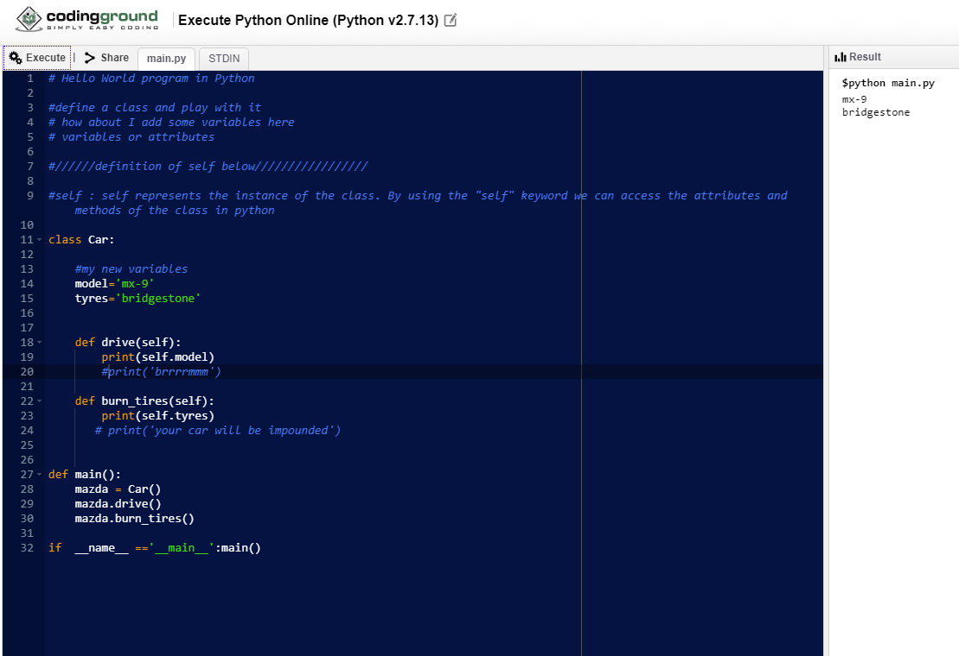
Self function

